Slide 1
Human Activity Recognition
Edwin Candinegara

Slide 2
FEATURES COMPARISON
Complex Human Activity Recognition Using Smartphone and Wrist-Worn Motion Sensors

Slide 3
Results (ACC + GYRO and ACC ONLY!)
The ACC + GYRO is also compared with our zero mean technique
The ACC ONLY is NOT compared with our zero mean technique
K-Fold
Their features are generally better
Except for default SVM
LOPO
Our features are still better (WITH AND WITHOUT zero mean!!)
True for both RF and SVM

Slide 4
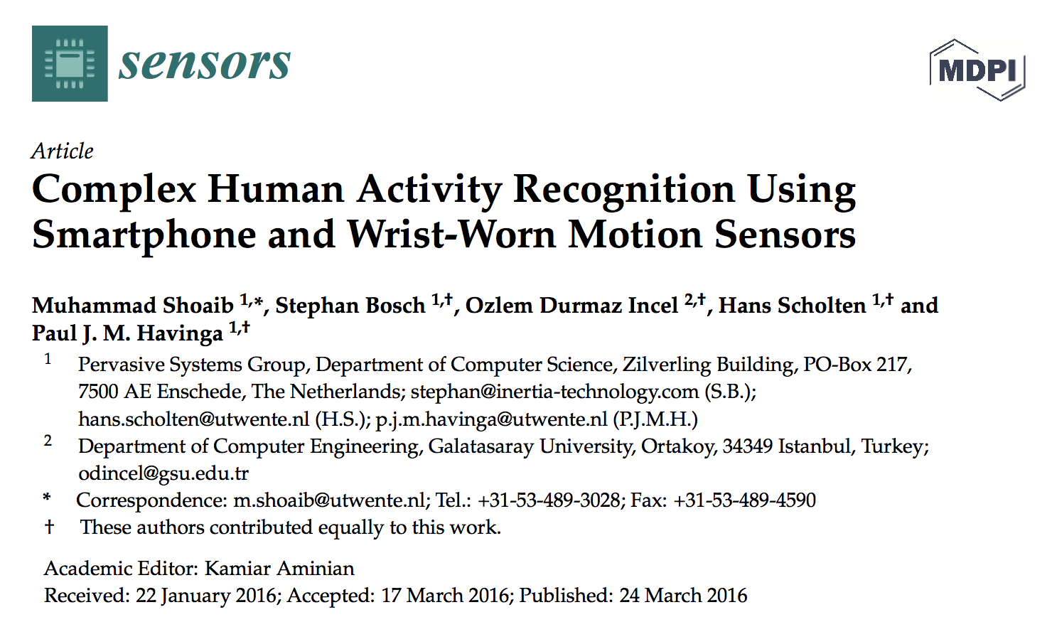

Slide 5
Summary
10 subjects (23-35 y.o.)
Not all activities are performed by each subject
Use 2 smartphones → pocket + wrist
Features:
Mean, Standard Deviation, Min, Max, Semi Quartile, Median, Sum of the First 10 FFT Coefficient
50Hz, 2-30s window sizes
3 classifiers → kNN, Naive Bayes, Decision Tree
10-fold CV → without shuffling!

Slide 6
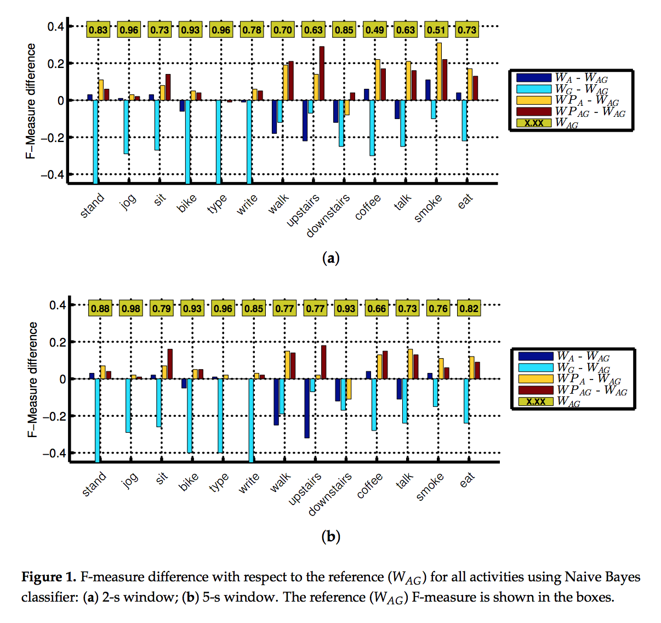
Notes:
Accelerometer + Gyroscope

Slide 7
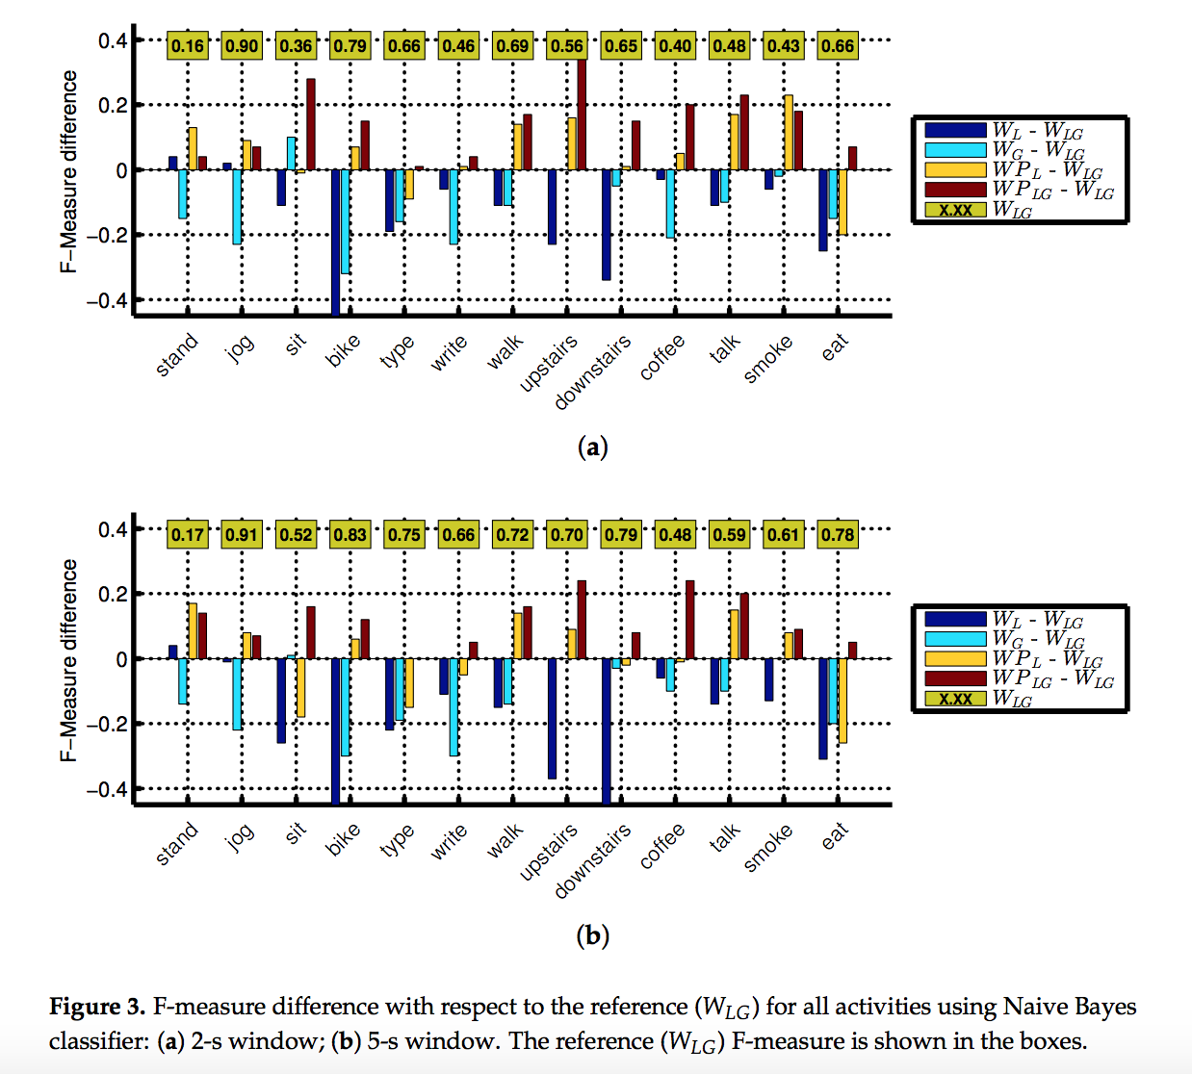
Notes:
Linear Accelerometer + Gyroscope

Slide 8
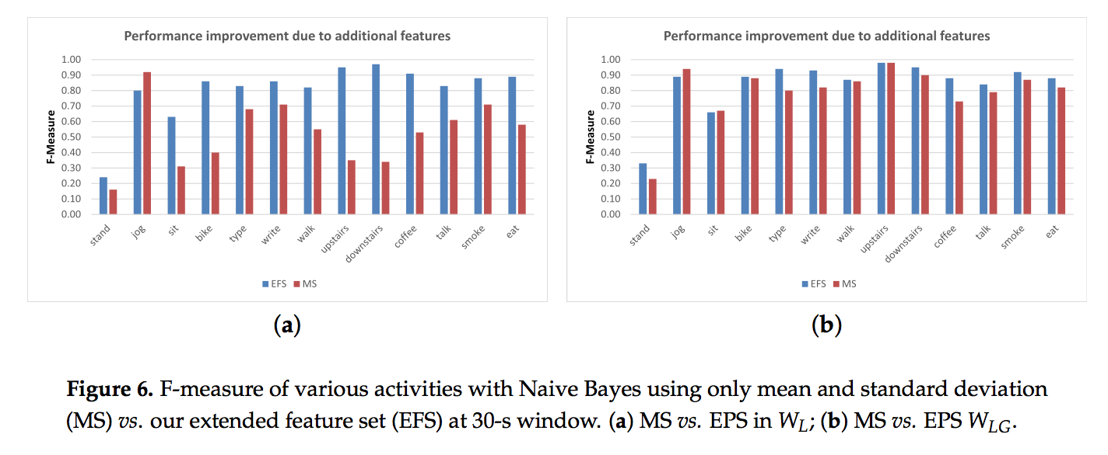

Slide 9
FEATURES COMPARISON
Smartwatch-based Activity Recognition: A Machine Learning Approach

Slide 10
Results (ACC ONLY!)
The ACC ONLY is NOT compared with our zero mean technique
K-Fold
Better than their features in all cases (RF/SVM/SVM DEFAULT, SP+SW/SP/SW)
LOPO
RF → better, but only slightly (around 0.5% difference)
SVM → much better (around 4-5% difference)

Slide 11
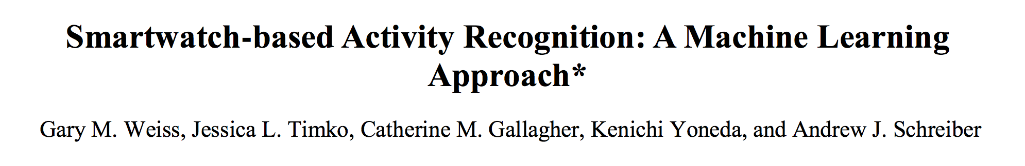
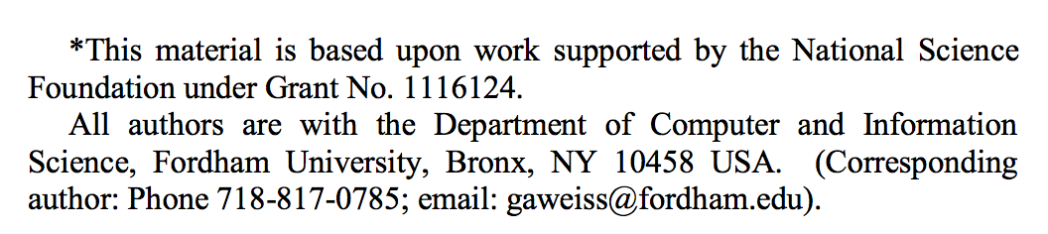

Slide 12
Summary
17 subjects, 18 activities
Smartphone, Smartwatch
43 Features (next slide)
20Hz, 10s window sizes
Classifiers → Random Forest, J48 Decision Tree, IB3 Instance-based Learning (kNN), Naive Bayes, MLP
Personal (using only the test subject’s data) Model → 10-fold CV
Impersonal Model → LOPO

Slide 13
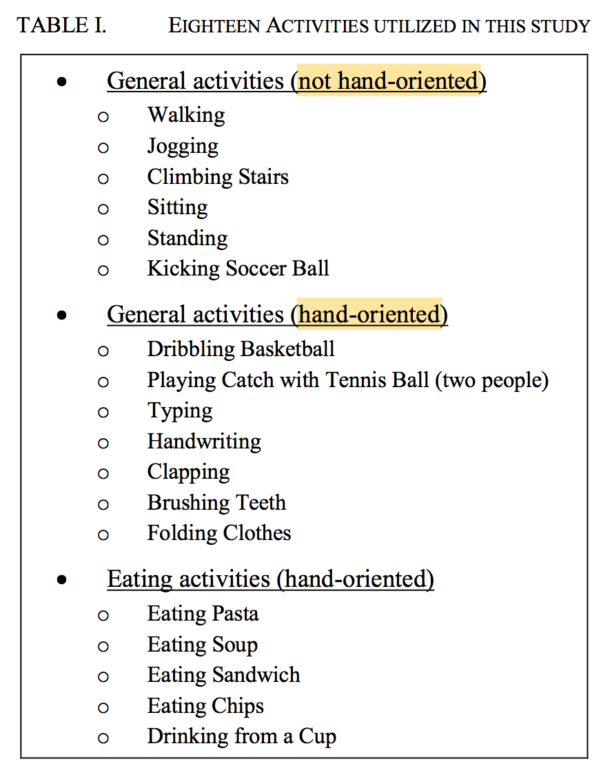

Slide 14
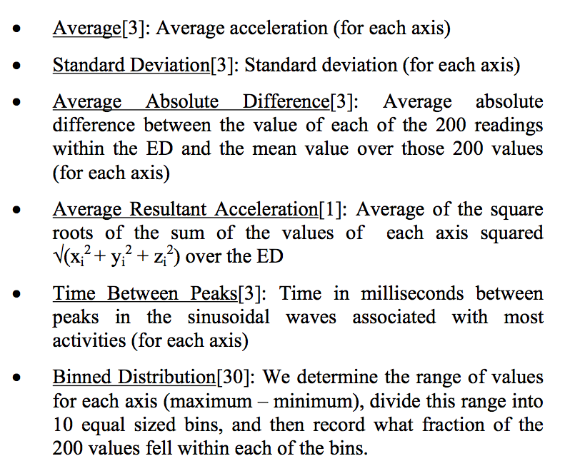
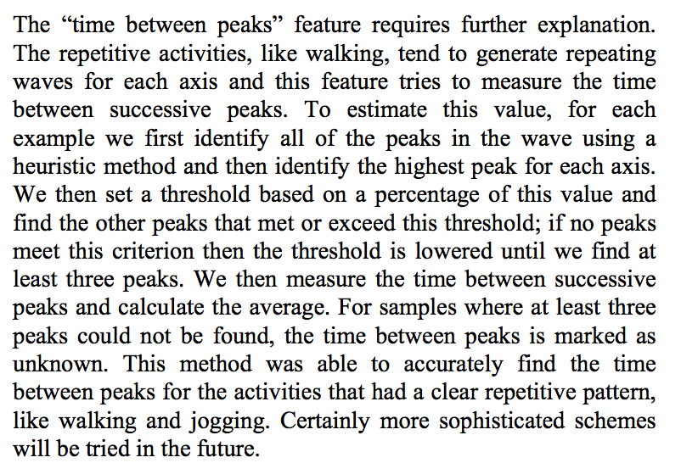
Notes:
heuristic but no explanation on the heuristic rule decision

Slide 15
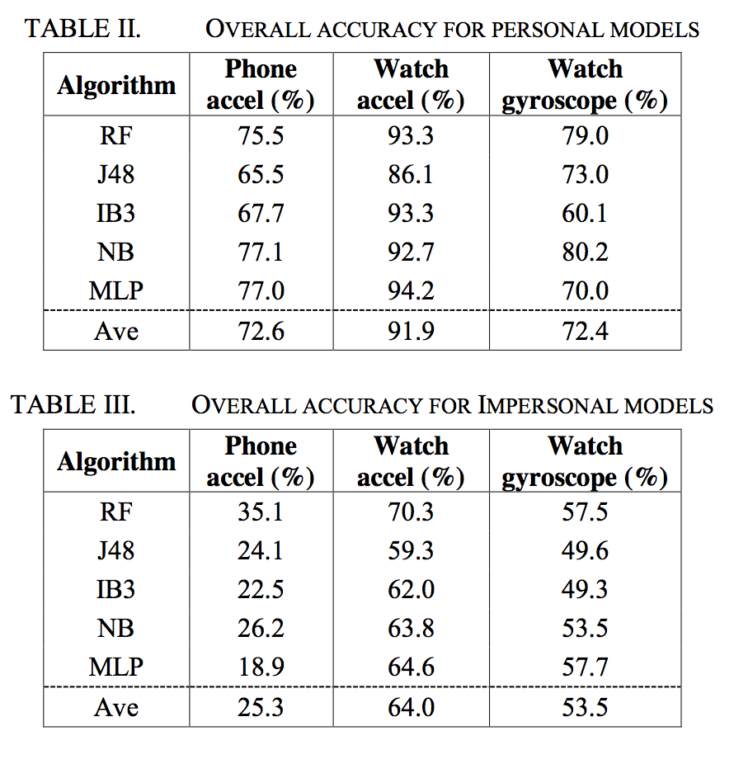

Slide 16
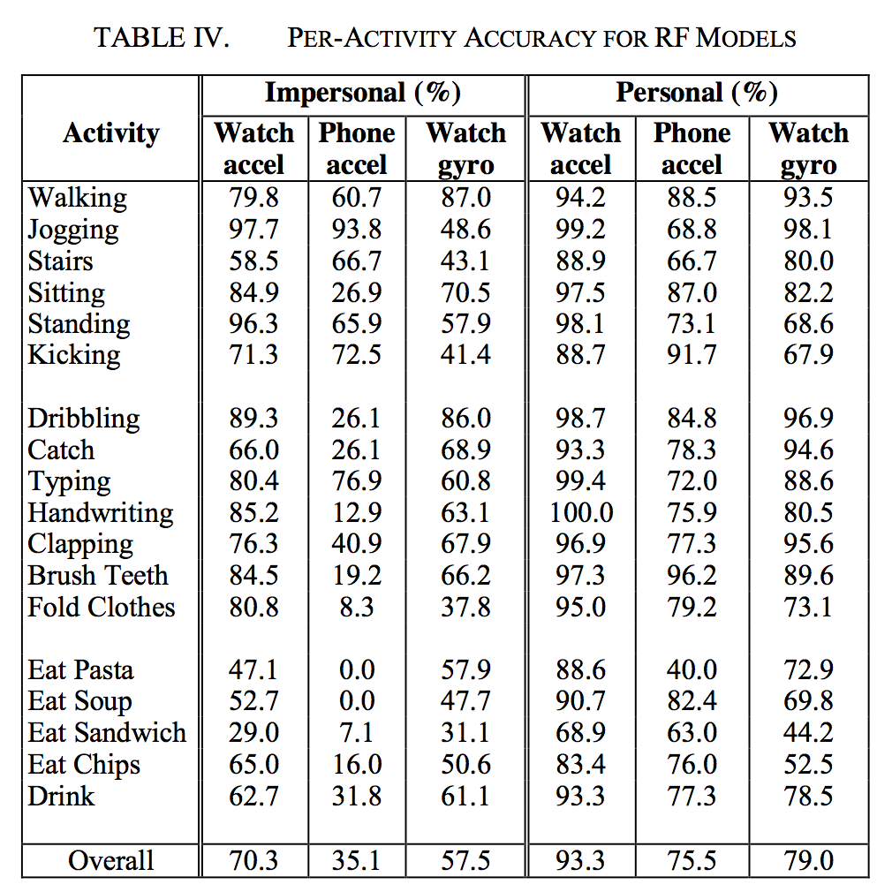

Slide 17
REAL TIME MONITORING
Demonstration

Slide 18
Others
Zero mean documentation done!
Tried finding whether there is any technique similar to zero mean used in a paper → cannot really find anything
Web Application → smoothing implemented

Slide 19
What’s next?
Interim report content?
Any feedback?
Deciding which results to use in the final report
Help Dr. Wang write part of the paper (?)

